Slide 1
Chapter 6
Program Understanding

Slide 2
Overview
Importance and aims of program comprehension
  Program domain, Execution effect, Cause effect relation, Product Environment relation. Decision Support Features
Maintainers and Their Information Needs
  Managers, Analysts, Designers, and programmers
Comprehension Process Models
  Read the program, read the source code and run the program
Mental Models
Program Comprehension Strategies
  Top-down
  Bottom up
  Opportunistic

Slide 3
Overview
Factors that Affect Understanding
  Expertise, Implementation issue, Documentation, Organization and Presentation of Programs, Comprehension support tools.
Implications of Comprehension Theories and Studies
  Knowledge acquisition, Education and Training, Design Principles, Guidelines and Recommendations

Slide 4
Program Comprehension
Prior to implementing any change, it is essential to understand the software product as a whole and the programs affected by the change in particular
Program comprehension is the process of reconstructing knowledge and relationship between problem and programming domains.
Program Comprehension involves:
  having a general knowledge of what the software system does and how it relates to its environment;
  identifying where in the system changes are to be effected; and
  having an in-depth knowledge of how the parts to be corrected or modified work.

Slide 5
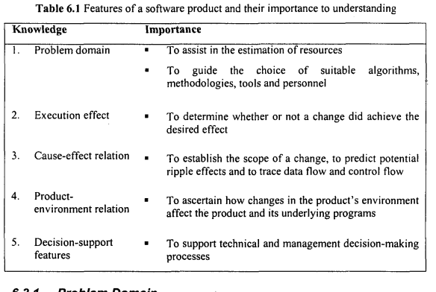
Features of a software product and their importance to understanding

Slide 6
Features of a software product and their importance to understanding
The ultimate purpose of reading and comprehending programs is to be able successfully to implement requested changes.
Problem Domain:
  Selection of personnel with the appropriate level of expertise and skills
  To direct maintenance personnel in the choice of suitable algorithms, methodologies and tools
Execution Effect
  Maintenance personnel need to know (or be able to predict) what results the program will produce for a given input
  It can assist the maintenance personnel to determine whether an implemented change achieved the desired effect

Slide 7
Features of a software product and their importance to understanding
3. Cause-Effect Relation:
To reason about how components of a software product interact during execution.
To predict the scope of a change and any knock-on effect that may arise from the change.
To trace the flow of information through the program. The point in the program where there is an unusual interruption of this flow may signal the source of a bug

Slide 8
Features of a software product and their importance to understanding
4. Product-Environment Relation:
To predict how changes in these elements will affect the product in general and the underlying programs in particular
5. Decision-Support Features:
Can guide maintenance personnel in technical and management decision-making processes like option analysis, decision making, budgeting and resource allocation
To determine which components of the system require more resource for testing.

Slide 9
Maintainers and Their Information Needs
Maintenance team - managers, analysts, designers and programmers - all have different comprehension or information needs depending on the level at which they function
Managers:
  To make informed decisions
  To estimate the cost and duration of a major enhancement
Analysts:
  To determine the functional and non-functional requirements, and to establish the relationship between the system the elements of its environment.
  To determine the implications of change (using context diagrams) on the performance of a system.

Slide 10
Maintainers and Their Information Needs
3. Designers:
The design process of a software system can take place at two levels:
Architectural design results in the production of functional components, conceptual data structures and the interconnection between various components.
Detailed design results in the detailed algorithms, data representations, data structures and interfaces between procedures or routines.
Data flow diagrams, control flow diagrams, structure charts and hierarchy process input/output (HIPO) charts can help the designer

Slide 11
Maintainers and Their Information Needs
4. Programmers:
Programmer needs to know the function of individual components of the system and their causal relation.
To decide on whether to restructure or rewrite specific code segments;
To predict more easily any knock-on effect when making changes that are likely to affect other parts of the system;
To hypothesise the location and causes of error.
To determine the feasibility of proposed changes and notify management of any anticipated problems.

Slide 12
Key Activities of Program Comprehension
Code Reading
Documentation Review
Identifying Software Architecture
Control Flow Analysis
Data Flow Analysis
Static Analysis
Dynamic Analysis
Reverse Engineering
Mental Model Building
Tool Utilization
Code Refactoring for Clarity
Traceability Mapping
Collaborative Code Review

Slide 13
Static Analysis
Analysis without executing the program.
Based on source code, intermediate code, or bytecode.
Performed early in development.

Slide 14
Key Activities of Static Analysis
Lexical Analysis - Tokenizing source code into identifiers, literals, operators, etc.
Syntax Analysis – Verifying grammar rules and structure (parse trees).
Semantic Analysis – Checking for type correctness, scope resolution, and meaning.
Control Flow Analysis - Identifying all possible paths through a program.
Data Flow Analysis - Tracking variable usage (definitions, uses, lifetimes).
Dependency Analysis – Discovering module, function, and variable interdependencies.
Style Checking - Verifying adherence to coding standards and conventions.
Security Flaw Detection - Identifying common security flaws (e.g., buffer overflows, injection)
Metrics Calculation - calculating LOC, complexity

Slide 15
Dynamic Analysis
Analysis during execution of the program.
Observes actual behavior and performance.
Requires input data and test environments.

Slide 16
Key Activities of Dynamic Analysis
Memory Leak Detection - Identifies unused memory that is not released, leading to potential performance issues.
Profiling (CPU, memory usage) - Measures resource usage (like CPU time and memory) to optimize performance.
Code Coverage - Analyzes which parts of the code are executed during testing to ensure sufficient test coverage.
Runtime Error Detection - Detects errors that occur during program execution, such as null pointer exceptions.
Behavior Monitoring - Observes how the application behaves under different conditions to detect anomalies.
Execution Tracing - Records the sequence of executed instructions or function calls to help in debugging and understanding flow

Slide 17
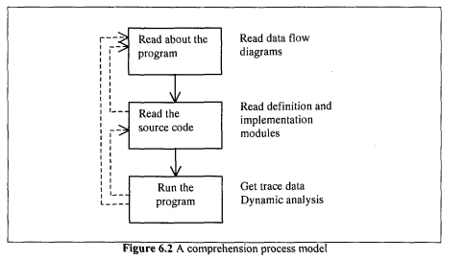
Comprehension Process Models
Three actions involved in the understanding of a program are: reading about the program, reading its source code, and running it.

Slide 18
Comprehension Process Models
Read about the program:
  The ‘understander' browses, peruses different sources of information such as the system documentation - specification and design documents - to develop an overview or overall understanding of the system.
  If system information (for many large, complex and old systems) is not accurate, this phase may be omitted

Slide 19
Comprehension Process Models
2. Read the source code:
The global and local views of the program can be obtained in this phase.
Global view is used to gain a top-level understanding of the system and to know effect a change might have on other parts of the system
Local view allows programmers to focus their attention on a specific part of the system. It gives detail about system's structure, data types and algorithmic patterns
Tools such as static analysers - used to examine source code - are employed during this phase

Slide 20
Comprehension Process Models
3. Run the program:
Study the dynamic behaviour of the program in action, including executing the program and obtaining trace data.
The benefit of running the program is that it can reveal some characteristics of the system which are difficult to obtain by just reading the source code.

Slide 21
Mental Models
Understanding how a system works, the behaviour of different parts, an algorithm, is known as the target system, and its mental representation is called a mental model.
Completeness and accuracy of the model depends to a large extent on its users' information needs.
Research in the area of programmers' cognitive behaviour during maintenance suggests that there are variations in the strategies that programmers use to understand (or form mental models of) programs.

Slide 22
Program Comprehension
Def: Program comprehension is the process of reconstructing knowledge and relationship between problem and programming domains.
Software development in its entirety can be considered to be a design task which consists of two fundamental processes.
Composition: It represents production of a design. Composition entails mapping what the program does in the problem domain, into a collection of computer instructions of how it works in the programming domain, using a programming language.
Comprehension: It is understanding the design produced by composition. It is a transformation from the programming domain to the problem domain involving the reconstruction of knowledge about these domains and the relationship between them.

Slide 23
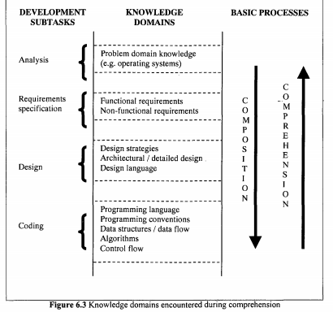
Program Comprehension
It commences with the inception of a vague and general hypothesis, known as the primary hypothesis.
This is then confirmed and further refined on acquisition of more information about the system from the program text and other sources such as the system documentation.

Slide 24
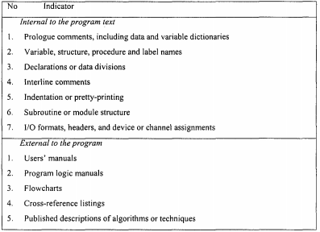
Beacons in Program Comprehension
The information required for hypothesis generation and refinement is manifested in key features - internal and external to the program - known as beacons.

Slide 25
Program Comprehension Strategies
A program comprehension strategy is a technique used to form a mental model of the target program.
The mental model is constructed by combining information contained in the source code and documentation with the assistance of the expertise and domain knowledge that the programmer brings to the task.
Some models of how programmers go about understanding program are:
Top-down
Bottom-up
Opportunistic

Slide 26
Program Comprehension Strategies
Top-down Model:
Tenet of the model: Understander starts by comprehending the top-level details of a program, such as what it does when it executes, and gradually works towards understanding the low-level details such as data types, control and data flows and algorithmic patterns in a top-down fashion
Cognitive Process: Top-down reconstruction of Knowledge domains and their mappings. Reconstruction is based on hypothesis creation, confirmation and refinement cycle.
Cognitive Structure: Problem and Programming domain knowledge. Potential Intermediate knowledge. Multiple layers of domain knowledge.

Slide 27
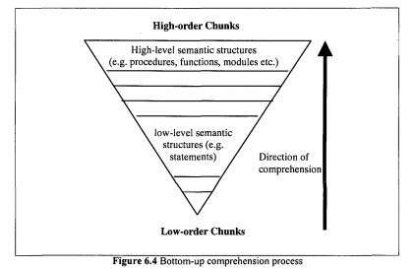
Program Comprehension Strategies
2. Bottom-Up / Chunking Model:
Tenet of the model: Programmer successively recognises patterns in the program and group them iteratively into high-level, semantically more meaningful structure.
Cognitive Process: Chunking recognised pattern into high level semantic structure.
Cognitive Structure: Mapping between knowledge domains.

Slide 28
Program Comprehension Strategies
Weaknesses of both the Top-down and Bottom-up comprehension strategies are:
Failure to take into consideration the contribution that other factors such as the available support tools make to understanding.
The fact that the process of understanding a program rarely takes place in such a well-defined fashion as these models portray. On the contrary, programmers tend to take advantage of any clues they come across in an opportunistic way.

Slide 29
Program Comprehension Strategies
3. Opportunistic Model:
Tenet of the model: Understander makes use of both bottom-up and top-down strategies.
According to this model, comprehension hinges on three key and complementary features - a knowledge base, a mental model and an assimilation process:
  A knowledge base: This represents the expertise and background knowledge that the maintainer brings to the understanding task.
  A mental model: This expresses the programmer's current understanding of the target program.
  An assimilation process: This describes the procedure used to obtain information from various sources such as source code and system documentation.

Slide 30
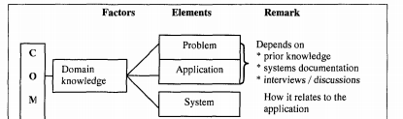
Factors that Affect Understanding
Following factors can affect formation of mental models of a program, and their accuracy, correctness and completeness.
Expertise:
There is a psychological argument that this expertise has a significant impact on comprehension. In many of these studies the performance of experts is compared with that of nonexperts (or novices). The expert tends to perform better than the novice.

Slide 31
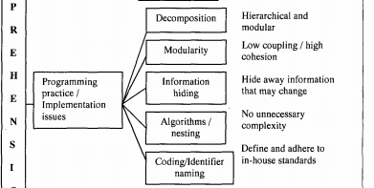
Factors that Affect Understanding
2. Implementation Issues:
There are several implementation issues that can affect the ease and extent to which a maintainer understands a program
Naming Style: Identifier names should be as informative, concise and unambiguous as possible.
Comments: Programs with high-level comments were easier to modify. Comments in programs can be useful only if they provide additional information.

Slide 32
Factors that Affect Understanding
2. Implementation Issues:
Decomposition Mechanism: Comprehensibility depends to some extent on how the entire software system has been decomposed
  Modular decomposition: It is a a technique for dividing large software systems into manageable components - called modules
  Structured programming: Approach of using high-level programming languages to reduce the size and complexity of programs

Slide 33

Factors that Affect Understanding
3. Documentation: Due to the high turnover of staff within the software industry, it is essential to maintain proper documentation.
Maintainers need to have access to the system documentation to enable them to understand the functionality, design, implementation and other issues.

Slide 34
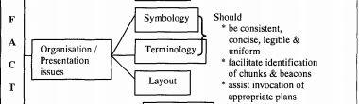
Factors that Affect Understanding
4. Organisation and Presentation of Programs:
Enhanced program presentation can improve understanding by
Facilitating a clear and correct expression of the mental model of the program
Emphasising the control flow the program's hierarchic structure and the programmer's - logical and syntactic - intent
Visually enhancing the source code through the use of
  Indentation
  Spacing
  Boxing and shading

Slide 35
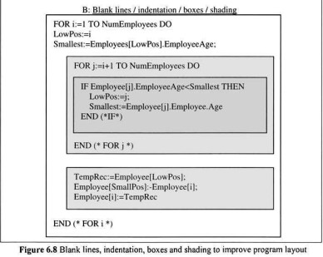
Factors that Affect Understanding
4. Organisation and Presentation of Programs:

Slide 36

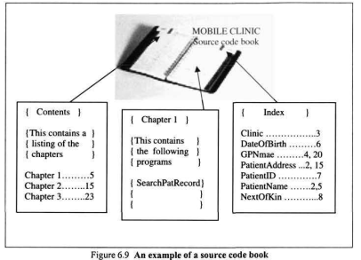
Factors that Affect Understanding
5. Comprehension Support Tools:
There are tools which can be used to organise and present source code in a way that makes it more legible, more readable and hence more understandable.
Example: “Book Paradigm” involves documenting source code using publishing features and style traditionally found in books.

Slide 37
Implications of Comprehension Theories and Studies
1. Knowledge Acquisition and Performance:
The knowledge that a maintainer requires for modifying a program depends on the nature of the change.
The maintainers who used a systematic strategy for program comprehension (similar to the opportunistic) were successful in making modifications because they gathered knowledge about the cause effect relation of the system's functional units.
2.Education and Training:
Maintainers need to be taught about program understanding. They can reflect on the appropriateness of the strategy that they usually use.

Slide 38
Implications of Comprehension Theories and
Studies
3. Design Principles:
Comprehension hinges on the ability to form an accurate mental model of the target program. Lessons can be learnt about appropriate principles for designing programs, programming languages, documentation standards and support tools that facilitate the formation of mental models.
4.Guidelines and Recommendations:
Results from empirical studies provide a basis for software maintainers to set guidelines for programming and documentation practices.

